Slide 1

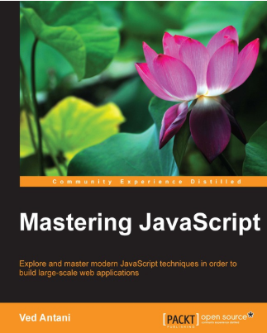
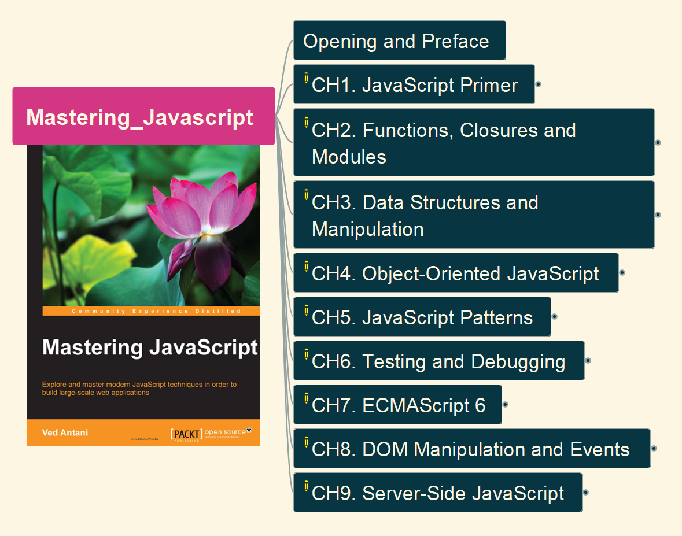
Mastering JavaScript by Ved Antani
001
Opening and Introduction

Slide 2
002

